Slide 1

PIZZA SALES ANALYSIS USING ZURE
- Sejal Ahire

Slide 2
Introduction
The problem this project addresses is related to businesses in the pizza industry looking to gain insights from their order data, understand customer behavior, and make data-driven decisions to improve their operations and revenue.
The core idea of the project is centered around leveraging Azure services and tools to process and analyze data related to pizza orders. It involves migrating on-premises SQL data to Azure Data Storage, using Azure Data Factory for data movement and transformation, employing Databricks for data processing and aggregation, and integrating the results into Power BI for analysis.

Slide 3
Services Used
AZURE DATA FACTORY
Azure Data Factory (ADF) is a cloud-based data integration service. it involves extracting, transforming, or loading (ETL) data.
ADF facilitates the creation, scheduling, and management of data-driven processes, allowing data engineers to seamlessly connect various data sources and destinations, both on-premises and in the cloud.
AZURE STORAGE ACCOUNT
An Azure Storage Account is a cloud service provided by Microsoft Azure for storing a variety of data, such as files, blobs, tables, queues, and virtual machine disks. It's highly scalable, durable, and accessible over the internet, making it suitable for a wide range of storage needs.
A container is a logical grouping of one or more blobs (objects or files). Containers are used to organize and manage data within a Storage Account. Internet
Notes:
First service is df,basically used for ETL, Next is storage. Used for storing variety of data,here I used container,it’s a grouping of data.

Slide 4
Services Used
AZURE DATABRICKS
Databricks provides a unified workspace, making it easy to build, train, and deploy machine learning models, process large datasets, and derive valuable insights from data.
It's designed to handle big data workloads and offers features like autoscaling, managed clusters, and deep integration with Azure services, making it a powerful solution for data-driven organizations.
POWER BI
Power BI is a powerful business intelligence and data visualization tool developed by Microsoft.
It allows users to connect to various data sources, transform and clean data, and create interactive, visually appealing reports and dashboards.
Notes:
Azure dbricks, is used to handle karge data and, derive insights from data.
Power bi is visualization tool alowers users to create interactive dashboards

Slide 5
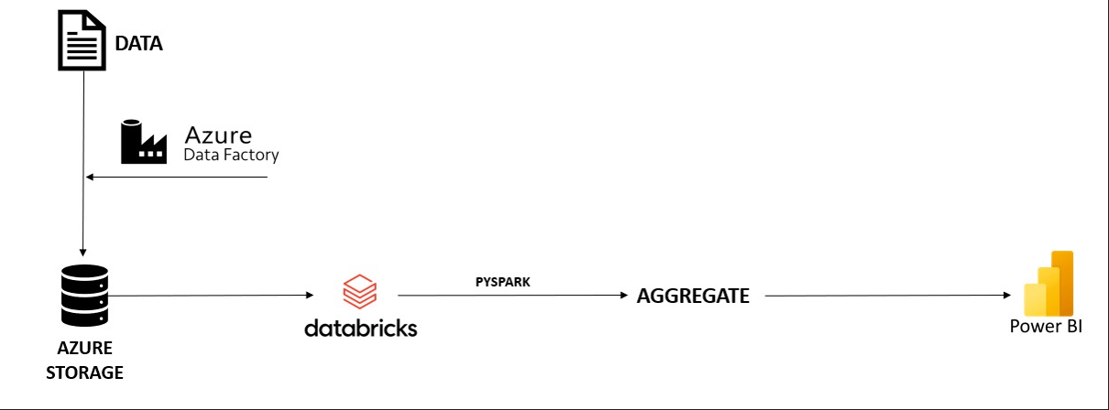
Basic workflow
Leveraging Azure services, it starts with automating data ingestion via Azure Data Factory, moving on-premises SQL data to Azure Storage. Azure Databricks then efficiently processes and aggregates the data, enabling the calculation of key performance indicators (KPIs) using pyspark and visualization using Power Bl
Notes:
This is the basic workflow of r proj.
Starts with..

Slide 6
Key Performance Indicators
Total Revenue
Average Order Value
Total Pizzas Sold
Total Orders
Average Pizzas Per Order
Total Pizza sold by pizza category
Monthly Trends for Total orders
Daily trends for Total orders
The sum of total sales by pizza_size
%of sales by pizza category Orders

Slide 7
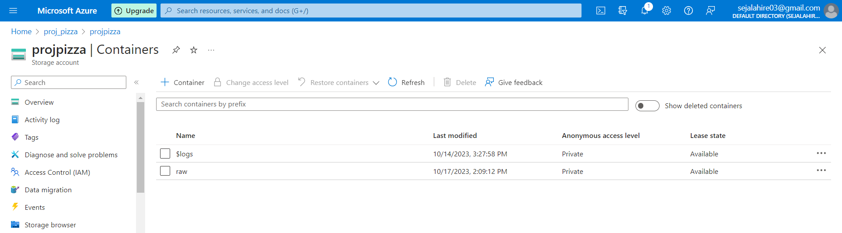
Azure blob Storage account,
Created a container “raw”
Notes:
So as workflow said,first will creatre storage acct and container called-raw.

Slide 8
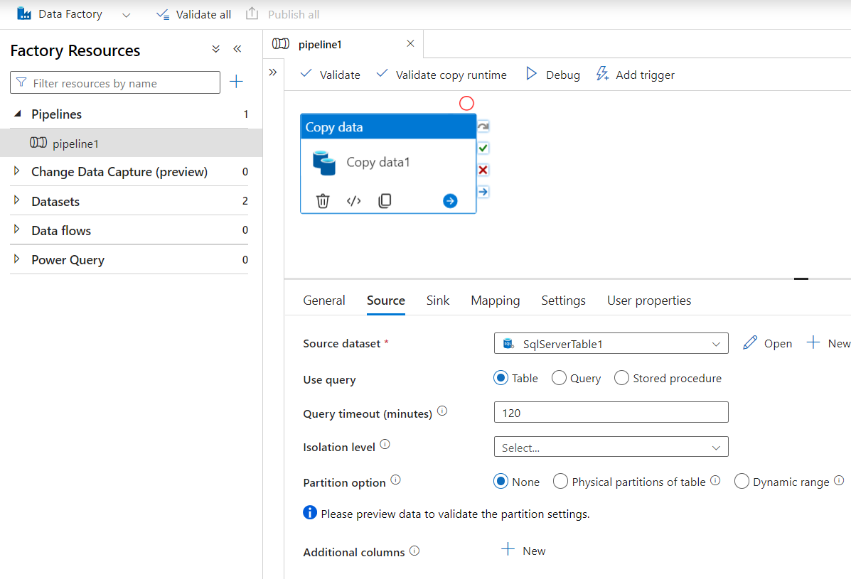
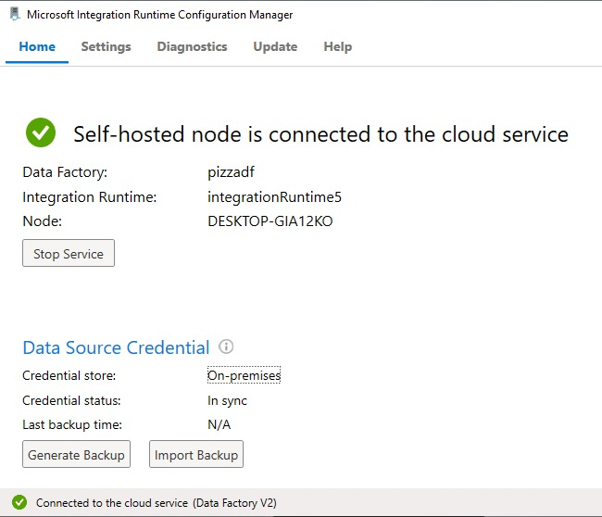
Create a data factory,
In the pipeline , use Microsoft Runtime Integration to integrate data into a container
Notes:
Next create a df pipeline,here we justr need our local data hosted on cloud.
So we provide all sources to copy data.
Then we integrate our sql data with cloud using Microsoft integration runtime .it will b a self hosted connection for on-prem daat,.
Omce the connectivity is done,will b able to view out data in our raw container.

Slide 9
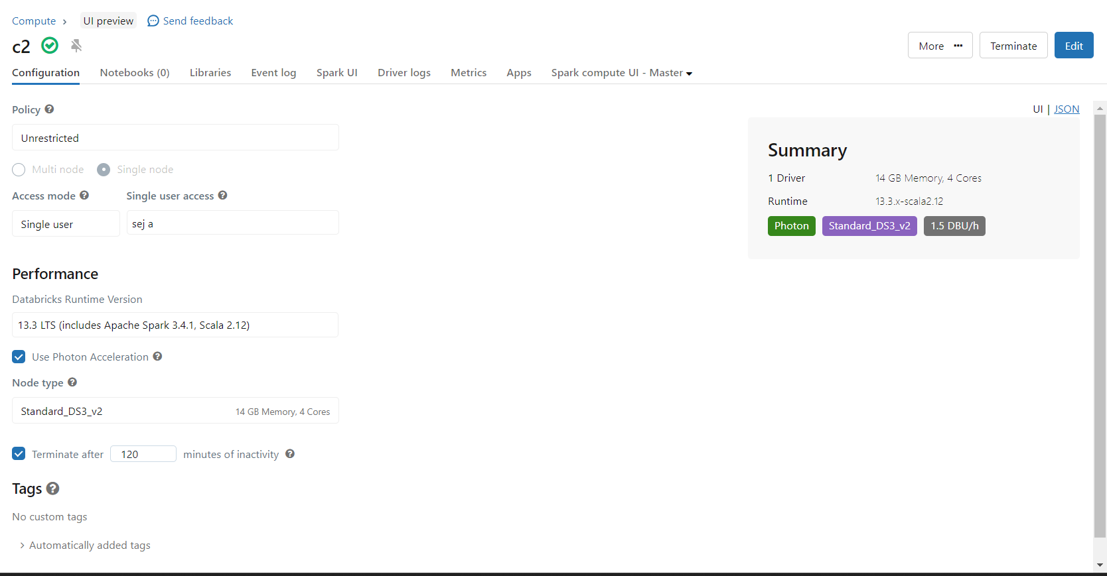
Databricks
Created a cluster “c2”.
Notes:
Next is databrciks, first we create a cluster c2,once the cluster is ctreated we create a notebook in workspace

Slide 10
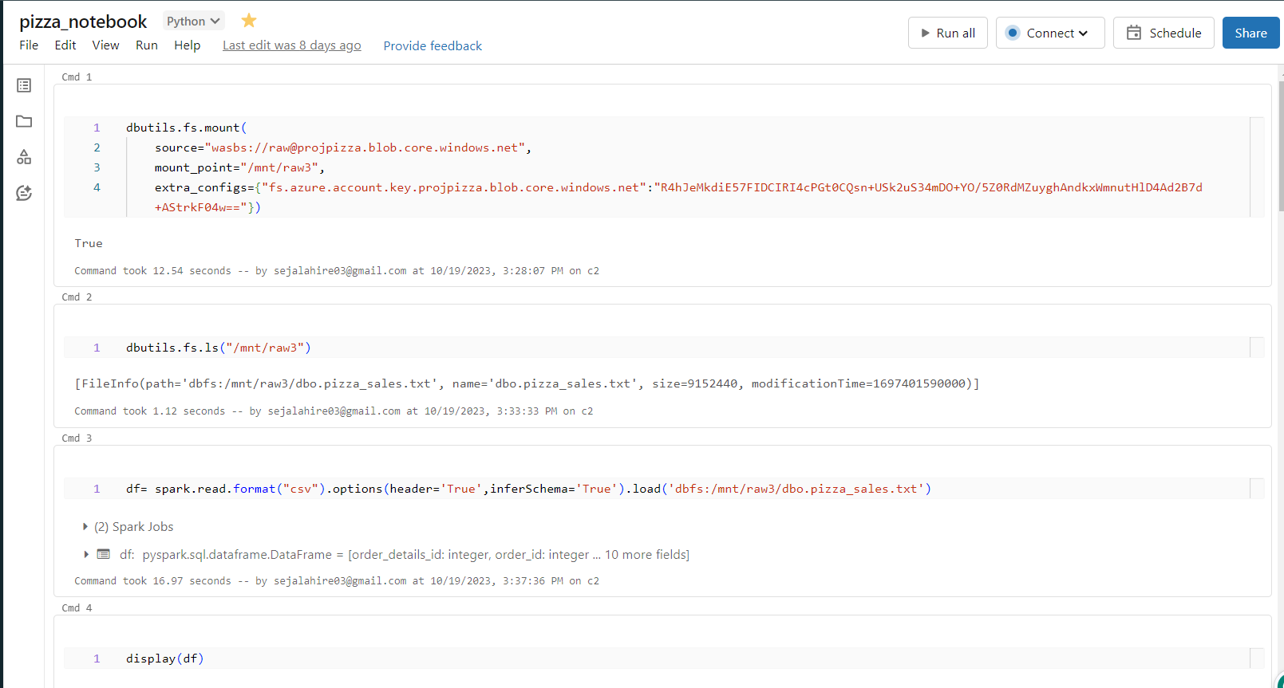
Databricks
Created a notebook and mounted our storage container to Databricks
Notes:
Here , we mount out storage comtainer to databrick so it caan access our data,once mounted ,will able to view our data

Slide 11
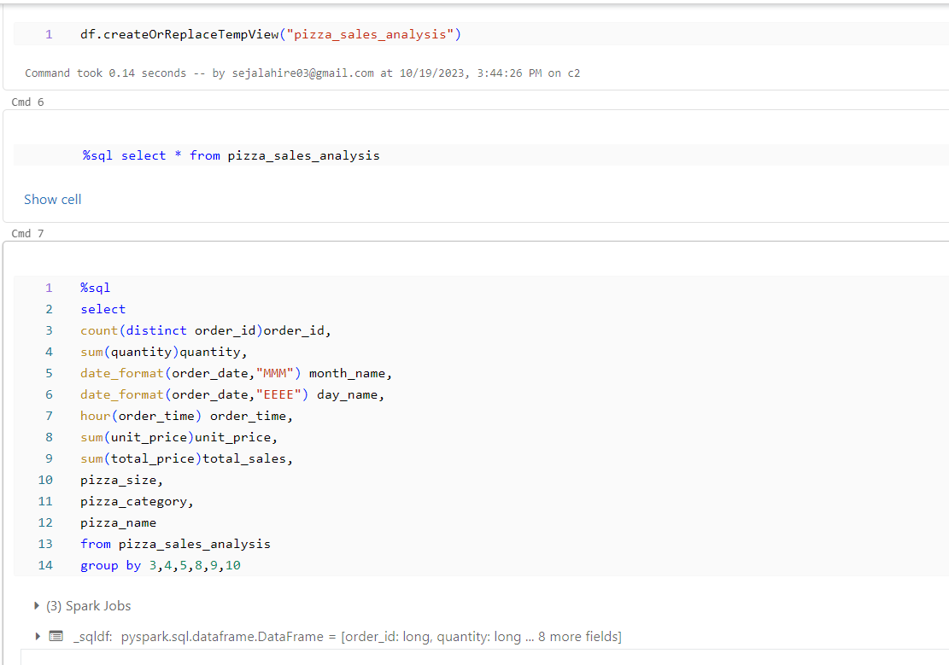
Databricks
Aggregates table
Notes:
After able to view data, we use spark sql to aggregate table. We crdarted new table which has out 10 cols whch are needed for analysis from original data.
Then we analyse it .

Slide 12
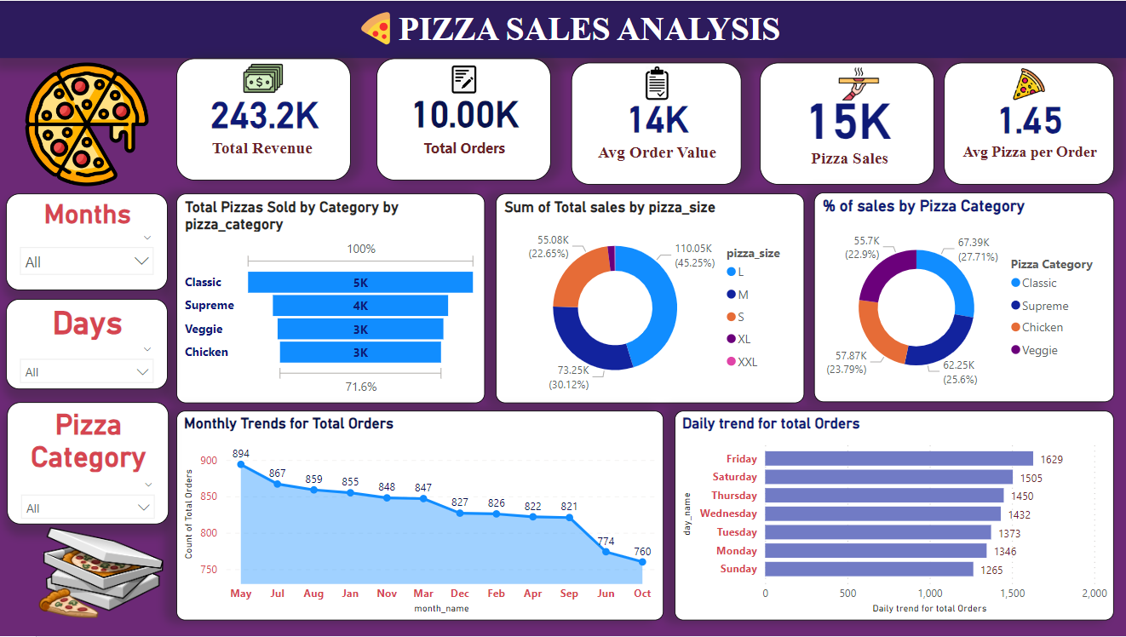
Power BI
Notes:
Visualizing is done using power bi. Sine I use free trail accnt, It doesn’t allow to internally integrate databrick to power vi,so we
dow nload then notebk and open it in power bi. Here er can see out 10 KPI which van be filter by months,days,an dpizza cateegory/.

